Slide 1
Power System Management

Slide 2
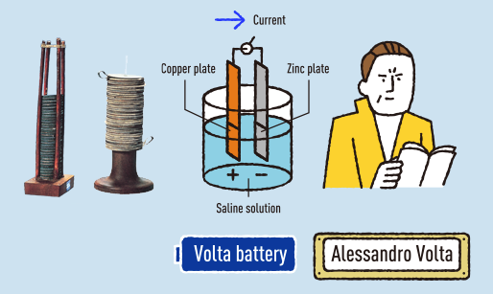
History of the creation of battery
Volta battery, was discovered by an Italian named Alessandro Volta, whom the battery was named after, in 1800.
When copper and zinc are placed into an electrolyte solution like dilute sulfuric acid or saline solution, the copper atoms barely break down at all, but the zinc atoms break down and electrons flow out. So the copper becomes a positive (+) pole and the zinc a negative (-) pole, and when the two are joined by a conductor, electricity flows from the copper to the zinc.

Slide 3
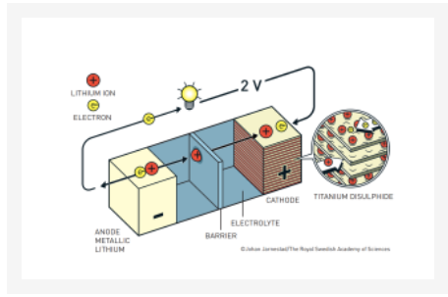
The History of the Lithium-Ion Battery
During the oil crisis in the 1970s, Stanley Whittingham tried using titanium disulfide and lithium metal as the electrodes, but the combination posed several challenges, including serious safety concerns. After the batteries short-circuited and caught on fire, he decided to halt the experiment.
John B. Goodenough, currently an engineering professor at the University of Texas at Austin, had another idea. In the 1980s, he experimented using lithium cobalt oxide as the cathode instead of titanium disulfide, which paid off: the battery doubled its energy potential.
Five years later, Akira Yoshino of Meijo University in Nagoya, Japan, made another swap. Instead of using reactive lithium metal as anode, he tried using a carbonaceous material, petroleum coke, which led to a revolutionary finding: not only was the new battery significantly safer without lithium metal, the battery performance was more stable, thus producing the first prototype of the lithium-ion battery.
Together, these three discoveries led to the lithium-ion battery as we know it. This lightweight, rechargeable and powerful battery is now used in everything from mobile phones to laptops and electric vehicles. It can also store significant amounts of energy from solar and wind power, making possible a fossil fuel-free society.

Slide 4
Types of batteries
PRIMARY | SECONDARY
Non-rechargeable Convenient sources of power for portable electronics and devices. | Rechargeable These batteries can be recharged and reused Used for energy storage devices, uninterrupted power supplies, Electric vehicles, Robots, and portable electronics devices.

Slide 5
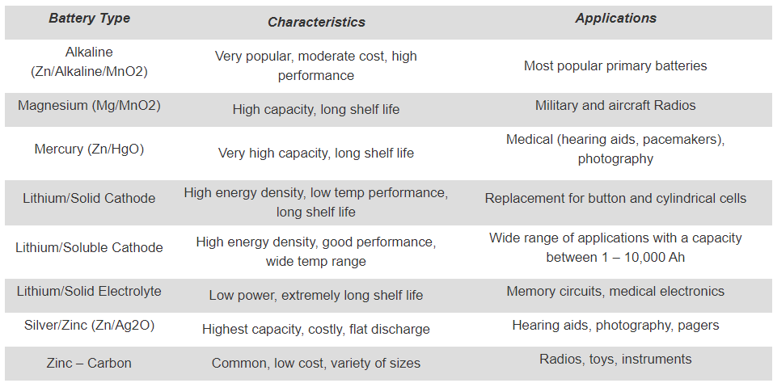
Types of Primary Batteries

Slide 6
How To Calculate Battery Run-Time
Q = I*t
where Q is the charge in coulombs, I is the current in amps and t is the time in seconds.
E = C*Vavg Where E is the energy stored in watt-hours, C is the capacity in amp-hours, and Vavg is the average voltage during discharge. Yes, watt-hours is a measure of energy, just like kilowatt-hours. Multiply by 3600 and you get watt-seconds, which is also known as Joules.

Slide 7
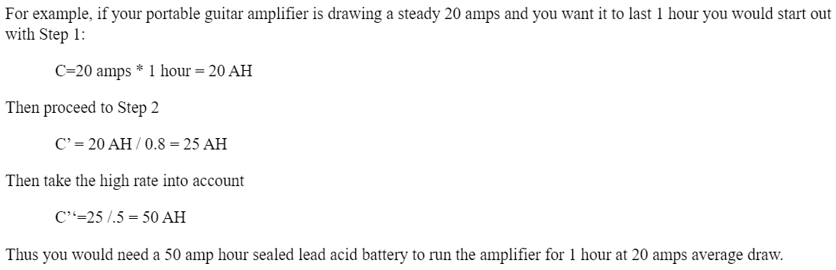
How To Calculate Battery Run-Time

Slide 8
Power For Autonomous Mobile Robots
Opportunity charging | Battery swap
Opportunity charging, for mobile robots, permits batteries to be charged several times during its working hours. The autonomous mobile robot or AGV goes to defined charging stations and performs charging while waiting for a new mission to be delivered. If the battery balance is properly calculated, the vehicle could never need a change of battery. Wireless charging is a form of opportunity charging | The mobile robot works with a single battery until it is fully drained that need to be swapped with a fully charged one. Battery swapping can be done manually or automatically as needed or on a schedule.

Slide 9
Wireless Charging for AMR and AGV
Contact charging | Inductive contactless charging
There’s is a physical connection between the charging poles | power transfer is done without any physical contact

Slide 10
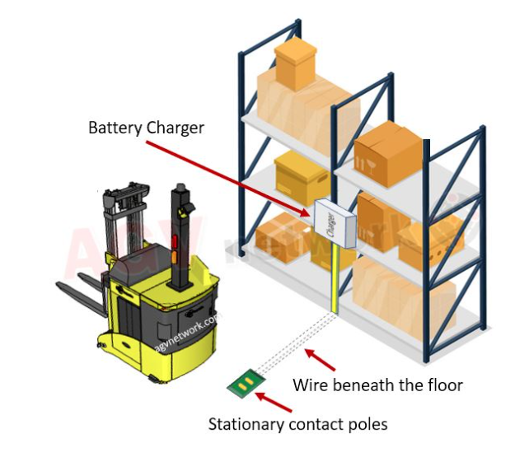
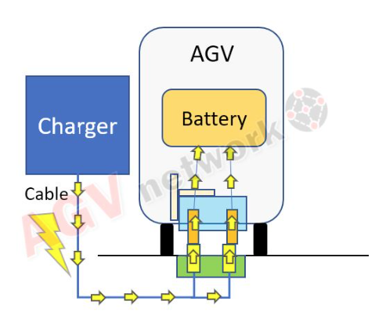
Contact Charging

Slide 11
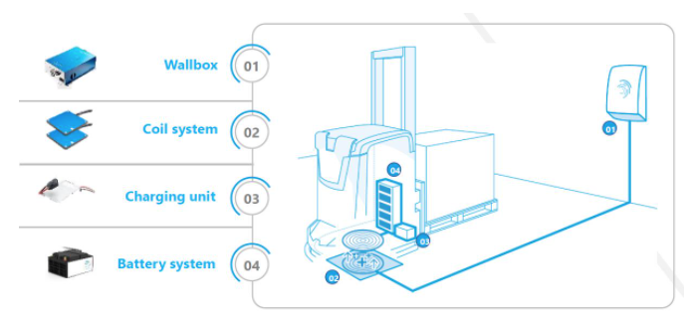
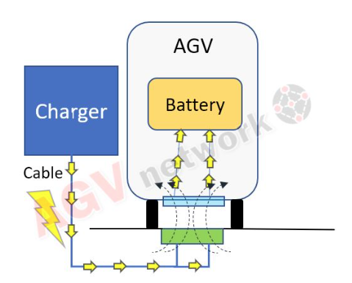
Inductive contactless charging

